Slide 1
FIRE Semester 1 Final Succinct Presentation
Public Health Research Project
Adam Kaushik, Richard Liang, Darwin Ma, Nikolay Pomytkin

Slide 2
Introduction
For our project, we measured the relationship between public health, socio-economic status, and the distances sample populations are away from cities
Our goal was to see how socio-economic status and urban sprawl affected public health
Our data came from two main sources: first, the Community Health Status Indicators (CHSI) dataset, which contains a variety of data on public health in thousands of U.S. counties
Our second source was the US Census Demographic Data, a dataset compiled from the 2015 government census data.

Slide 3
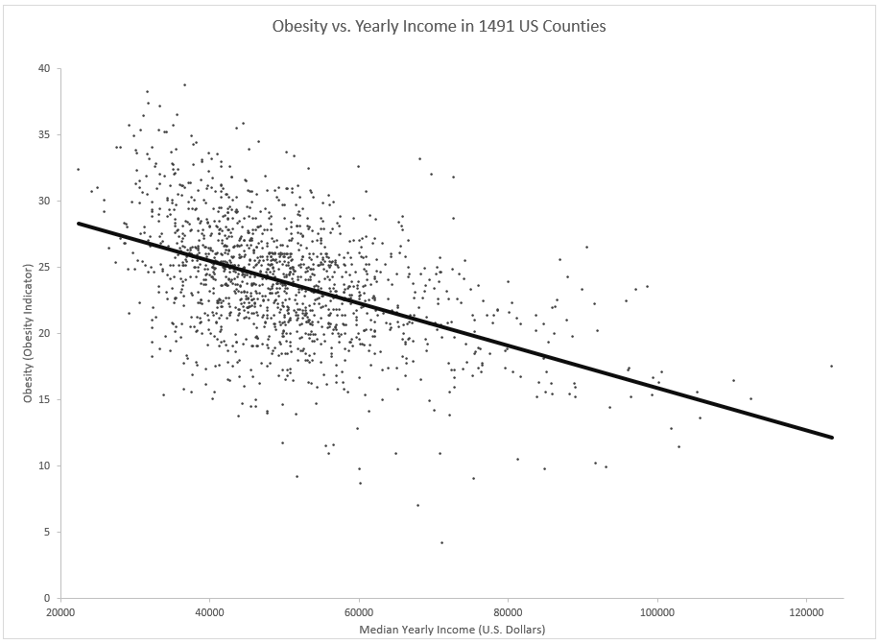
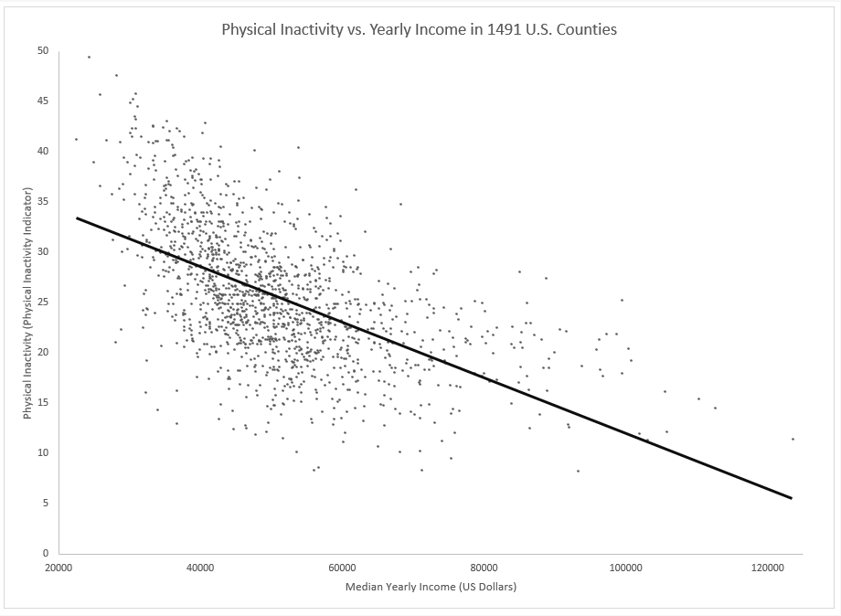
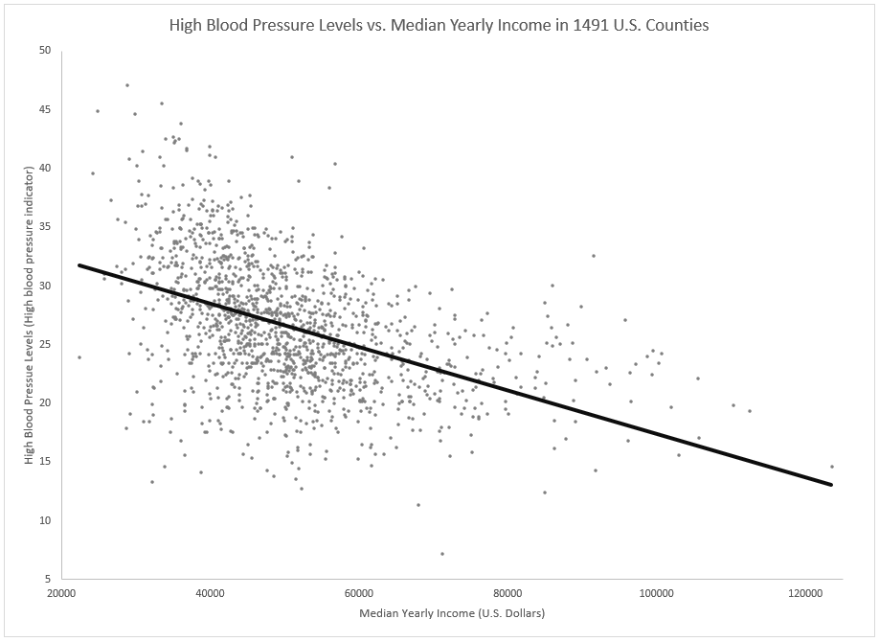
Result 1
One aspect we wanted to explore was how income affected obesity in different counties
Overall, we see that the better off people are (financially), the less obese they tend to be.
Like obesity, another relevant health-determining factor is physical inactivity
Overall, those with more money are more physically active
People who can afford urban residences can walk to access basic commodities; those in cheaper suburbs require a car
High blood pressure is third variable in dataset important to the study
As expected by now, we saw that wealthier people generally had lower blood pressure

Slide 4
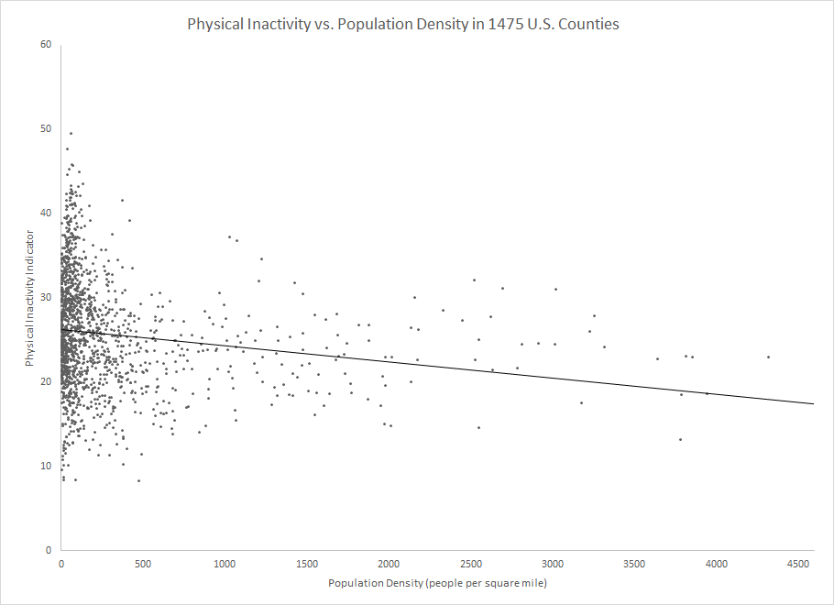
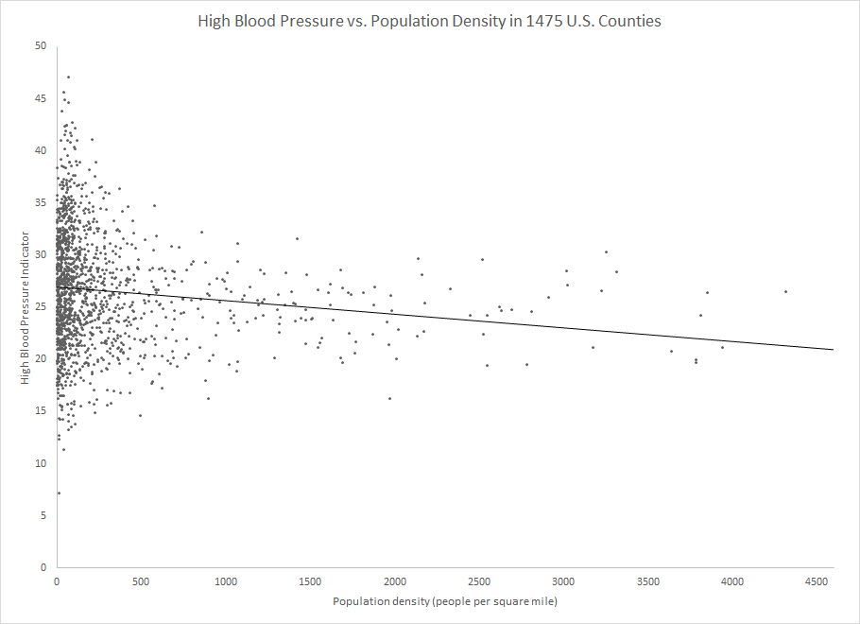
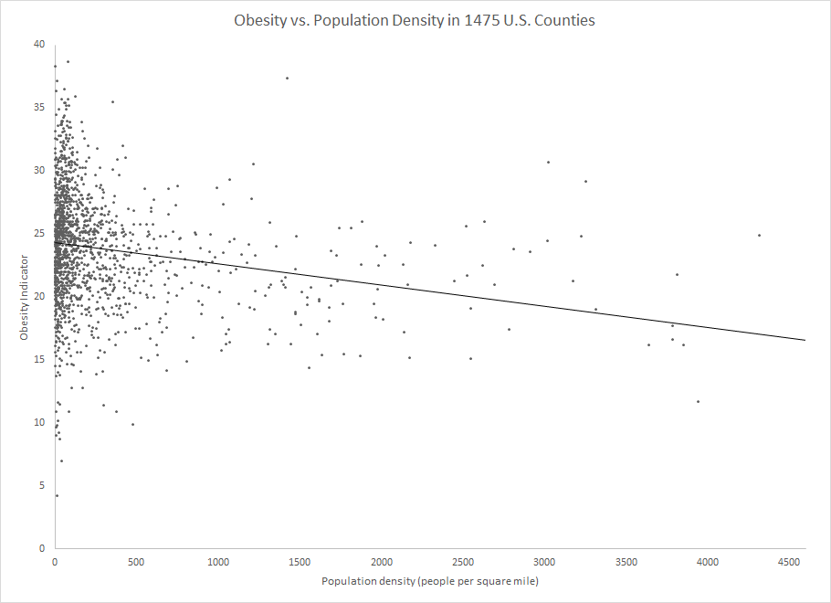
Result 2
In addition to studying the relationship between income and the various health indicators, we also used a dataset that provided population density data on U.S. counties.
Although the correlation between the indicators and population density was weaker than with income, there was a clear trend.
Implications:
People living in more urban/suburban areas (closer to cities) tend to have higher levels of physical activity and have greater health indicators on average.
Can be explained by the fact that people living in cities tend to utilize public transportation and lead more active lifestyles.
There is a clustering of data at the lower population densities because there are a lot of counties with <500 ppl. per sq. mile, because there are a lot more counties in suburban/urban areas.
Despite this, there is still a clear trend that shows that people living in more densely populated regions are healthier on average.

Slide 5
Discussion & Conclusions
Measured the relationship between public health, socio-economic status, and the distance sample populations are from cities
Focus on public health and healthcare availability to our study’s participants
Obesity, blood pressure levels, and physical inactivity increase with a lower income and decreased population density
Life expectancy and longevity increase with a higher income
Lower income increase in risky behaviors, such as drugs and alcohol
Lower income many problems including but not limited to lowered employment and education, increase in stress, depression, aging-related chronic diseases, and social inequality
Increase in income, socio-economic status, and population density, there is a positive correlation with public health
Socio-economic gap is very harmful for those in a lower class, as they have a lower public health
Very hard to fix, no clear solution
Steps being taken involve food stamps, raising awareness for drugs and alcohol, and making healthcare more affordable are all steps which are being taken to improve the public health of those of a lower income.

